Slide 1
CSC-257 Theory Of Computation (BSc CSIT, TU)
Ganesh Khatri
kh6ganesh@gmail.com

Slide 2
Conversion of CFG to PDA
Step 1 : Convert the given productions of CFG into GNF.
Step 2 : The PDA will only have one state {q}.
Step 3 : The initial symbol of CFG will be the initial symbol in the PDA.
Step 4: For non-terminal symbol A, add the following rule :
δ(q, ε, A) = (q, α), where the production rule is A → α
Step 5 : For each terminal symbols, add the following rule :
δ(q, a, a) = (q, ε) for every terminal symbol a

Slide 3
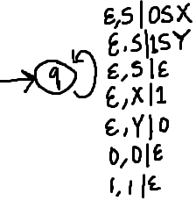
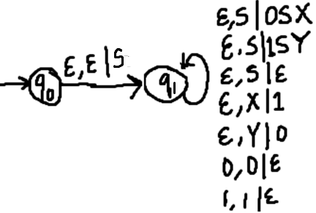
Conversion of CFG to PDA
Example : Convert the following CFG into PDA
S → 0SX | 1SY | ε
X → 1
Y → 0
Here, given grammar is already in GNF
The PDA can be given :
P = {(q), (0, 1), (S, X, Y, 0, 1), δ, q, S, q}
The production rule δ can be :
R1 : δ(q, ε, S) = {(q, 0SX) | (q, 1SY) | (q, ε)}
R2 : δ(q, ε, X) = {(q, 1)}
R3 : δ(q, ε, Y) = {(q, 0)}
R4 : δ(q, 0, 0) = {(q, ε)}
R5 : δ(q, 1, 1) = {(q, ε)}
or
Notes:
or

Slide 4
Conversion of CFG to PDA
Rules :
R1 : δ(q, ε, S) = {(q, 0SX) | (q, 1SY) | (q, ε)}
R2 : δ(q, ε, X) = {(q, 1)}
R3 : δ(q, ε, Y) = {(q, 0)}
R4 : δ(q, 0, 0) = {(q, ε)}
R5 : δ(q, 1, 1) = {(q, ε)}
Testing 1010 against PDA :
δ(q, 1010, S) ⊢ δ(q, 1010, 1SY) R1
⊢ δ(q, 010, SY) R5
⊢ δ(q, 010, 0SXY) R1
⊢ δ(q, 10, SXY) R4
⊢ δ(q, 10, XY) R1
⊢ δ(q, 10, 1Y) R2
⊢ δ(q, 0, Y) R5
⊢ δ(q, 0, 0) R3
⊢ δ(q, ε, ε) R4
String accepted by empty stack method.

Slide 5
Conversion of CFG to PDA
Exercise :
Construct PDA for the given CFG, and test whether 010000 is acceptable by this PDA.
S → 0BB
B → 0S | 1S | 0
Construct PDA for the given CFG, and trace the acceptance of a + (a*a)
E → T | E + T
T → F | T * F
F → a | (E)

